Slide 1
The proposal of calculating contact force between two convex objects by 6 DoF constraints （6自由度拘束による接触力計算手法の提案）
18M14598
M1 Kim SaeYoung

Slide 2
Index
Backgrounds
What is the simulation based on analytical method
How to calculate the contact in simulation based on analytical method
The problem of using calculating method based on contact point
The problem of conventional method
The problem of related work
Purpose
Proposal
Experiment
Conclusion
Future work
Appendix A. Zero moment point(ZMP)
Appendix B. The data of Experiment
Appendix C. Dynamical scene
Appendix D. The Algorithm of finding the closest point from constrained ZMP
Appendix E. Euclidean projection

Slide 3
Background
The physics engine plays the role to give autonomy to virtual world
There is close relationship between physics engine and virtual word(for example, Real-time property etc.).
Recent physics engine use the analytical method for simulation

Slide 4
What is the simulation based on analytical method (1)
The simultaneous equation are formulated by the motion of two objects.
From physical constraints, this equation can be Linear Complementarity Problem (LCP).
It is possible to get the resolution of two objects` motion (Impulses , relative velocities and angular velocities from impulses) on next time.

Slide 5
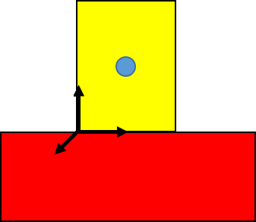
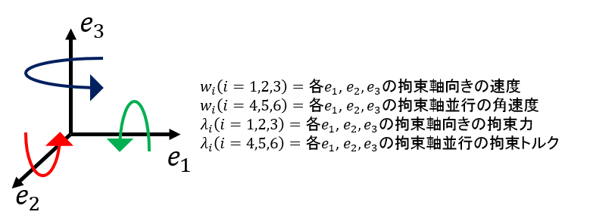
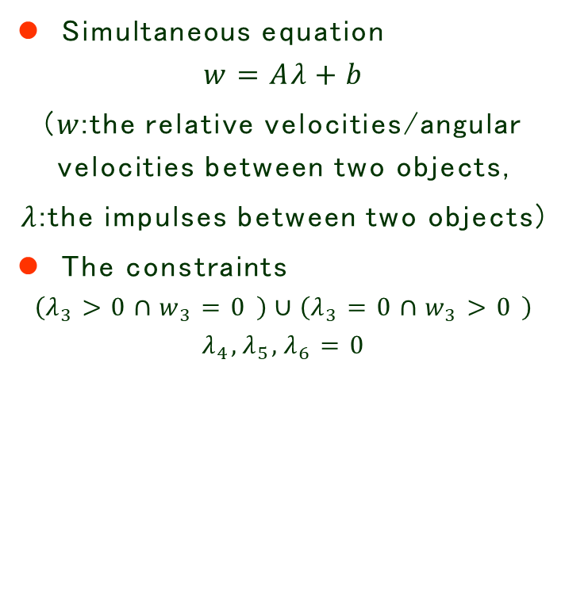
What is the simulation based on analytical method (2)
Simultaneous equation
$$w=Aλ+b$$
($w$:the relative velocities/angular velocities between two objects,
$λ$:the impulses between two objects)
The constraints
$$\left(λ_{3}>0∩w_{3}=0 \right)∪\left(λ_{3}=0∩w_{3}>0 \right)$$
$$λ_{4},λ_{5},λ_{6}=0$$
Figure 1 example of contact between two objects
Notes:
とがっていることが論理

Slide 6
How to calculate the contact in simulation based on analytical method
The conventional method to calculate the contact, (1) Calculate the contact manifold from two objects when there is collision between them (2) Solve the simultaneous equations generated from each vertex by using physical constraints(equally, resolve the impulse and velocities based on contact point)
Figure 2 The contact manifold generated from contact between two objects
Notes:
半透明なものはちゃんと書く！線を

Slide 7


















The problem of using calculating method based on contact points (1)
Method of calculating simultaneous equation based on contact points causes processing time to increase
$$A_{1}$$
$$λ_{1}$$
$$b_{1}$$
$$A_{2}$$
$$λ_{2}$$
$$b_{2}$$
$$A_{3}$$
$$λ_{3}$$
$$b_{3}$$
$$A_{4}$$
$$λ_{4}$$
$$b_{4}$$
$$A_{5}$$
$$λ_{5}$$
$$b_{5}$$
$$A_{6}$$
$$λ_{6}$$
$$b_{6}$$
Figure 3 The relation between The number of contact points and The number of simultaneous equation
Page 10

Slide 8
The problem of using calculating method based on contact points (2)
Method of calculating simultaneous equation based on contact points causes ambiguity to set appropriate contact points when Convex object with shape of curve is collided
Figure 4 The contact manifold between cylinder and box

Slide 9

The problem of conventional method (1)
The conventional method regards cylinder as the object with shape of polygon.
But This method cause motion different from ideal moving when using polygon cylinder.
Movie 1 The example of different moving (72 polygon)

Slide 10
The problem of conventional method (2)
From The problem of using calculating method based on contact points (1)(page 7), this method also can make the calculation time to increase when cylinder is used in simulation
Figure 5 the contact manifold of Polygon cylinder

Slide 11
The problem of related work (1)
6D Frictional Contact for Rigid Bodies [1]
Purpose : Rolling and spinning cannot be calculated from one contact point in conventional method. So, this research purpose how to calculate the rolling and spinning torque from only one contact point.

Slide 12
The problem of related work (2)
This research use concept of CoP(center of pressure) and calculate the intersection shape for projection of CoP by using GPU
In case of creating the computer games, for general diffusion, the simulation without GPU has possibility to increase market competitiveness

Slide 13
Purpose
(1) To propose calculating method of the contact between two object based on contact surface without using GPU.
(2) To keep the fidelity of motion and decrease the processing time compared to conventional method.

Slide 14
Comparison between conventional method and proposal (1)
Collsion detection
Iterative method
Simultaneous equation
The steps of
recursion formula
Calculating
constraint force &
constraint torque
Projection by constraints
Renewing
velocities and position
Figure 6 The process of calculating contact force and torque

Slide 15
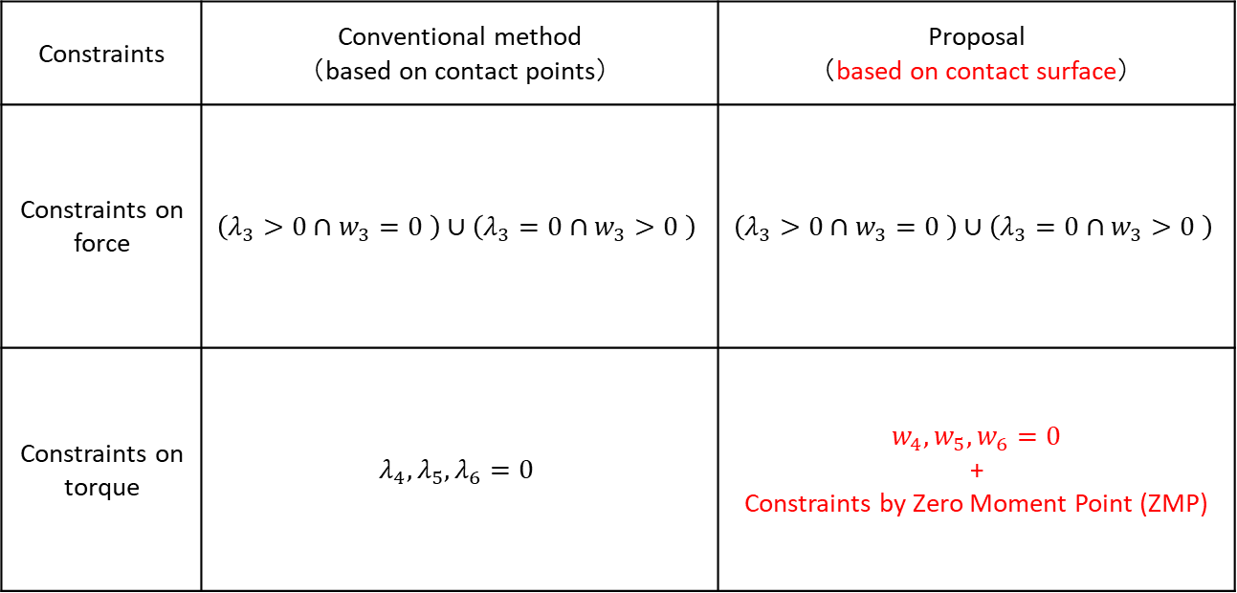
Comparison between conventional method and proposal (2)
Table 1 Comparison between conventional method and proposal
Constraints | Conventional method （based on contact points） | Proposal （based on contact surface）
Constraints on force | $$\left(λ_{3}>0∩w_{3}=0 \right)∪\left(λ_{3}=0∩w_{3}>0 \right)$$ | $$\left(λ_{3}>0∩w_{3}=0 \right)∪\left(λ_{3}=0∩w_{3}>0 \right)$$
Constraints on torque | $$λ_{4},λ_{5},λ_{6}=0$$ | $$w_{4},w_{5},w_{6}=0$$ + Constraints by Zero Moment Point (ZMP)
Notes:
接触点と接触面に基づいたときの計算する点の数が変わるという図と表を一緒に見せる。
・・ ここからスタート（PESummit）

Slide 16
Proposal (1)
To set the relative angular velocities will be 0 only can cause unnatural motion
Unnatural motion means that the object don`t tumble down like figure 7
Figure 7 The example of unnatural motion

Slide 17
Proposal (2)
Unnatural moving is generated from binding relative angular velocities ONLY
For removing unnatural moving, we find the condition whether object falls down or not
This condition can be generated by calculating Zero Moment Point (ZMP)

Slide 18
Constraint by ZMP (1)
ZMP means that the point with respect to reaction force
The sum of moment is 0 on ZMP
ZMP must exist on contact manifold
Figure 8 The example of ZMP

Slide 19
Constraint by ZMP (2)
If ZMP exists out of contact manifold, the object must fall down.
The motion between two objects can be predicted by using Where ZMP exists (inside or outside contact manifold)
Figure 9 The relation between motion and ZMP

Slide 20
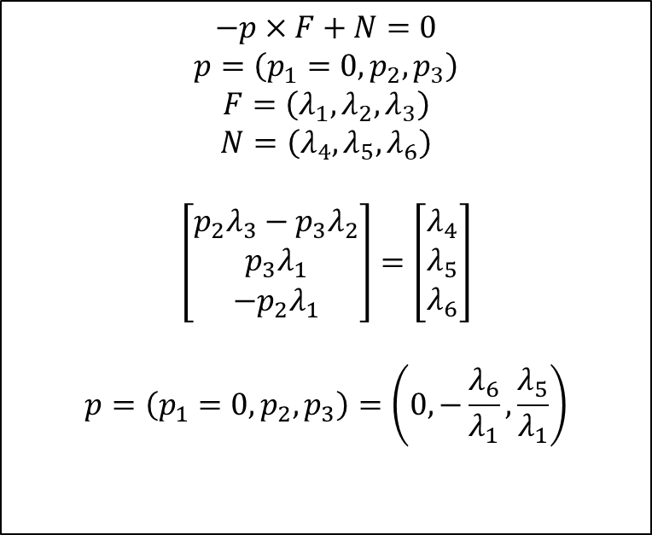

Constraint by ZMP (3)
To calculate ZMP if there is no falling down (equally, constraint angular velocity)
$$−p×F+N=0$$
$$p=\left(p_{1}=0,p_{2},p_{3}\right)$$
$$F=\left(λ_{1},λ_{2},λ_{3}\right)$$
$$N=\left(λ_{4},λ_{5},λ_{6}\right)$$
$$\left[\begin{matrix}p_{2}λ_{3}−p_{3}λ_{2} \\ p_{3}λ_{1} \\ −p_{2}λ_{1}\end{matrix}\right]=\left[\begin{matrix}λ_{4} \\ λ_{5} \\ λ_{6}\end{matrix}\right]$$
$$p=\left(p_{1}=0,p_{2},p_{3}\right)=\left(0,−\frac{λ_{6}}{λ_{1}},\frac{λ_{5}}{λ_{1}}\right)$$
$$F=\left(λ_{1},λ_{2},λ_{3}\right)$$
$$N=\left(λ_{4},λ_{5},λ_{6}\right)$$
p
Figure 10 How to calculate ZMP
Notes:
この説明もいる

Slide 21
Proposal (3)
Contact state judging algorithm
The closet point finding algorithm

Slide 22
Proposal (4)
Contact state judging algorithm can help to detect whether contact manifold exists or not
Figure 11 The example of judging contact state

Slide 23
Proposal (5)
(1) surface to surface
(2) surface to point
Figure 12 the case of contact state

Slide 24
Proposal (6)
the closet point finding algorithm can help to where the ZMP must be moved
In my research, the concept of support point is used for finding the closet point, and this algorithm is generic for only convex objects
Figure 13 example of finding the closest point

Slide 25
Proposal (7)
But, there are two candidates for moving ZMP because we don`t know any information of contact manifold.
(1) Contact manifold is generated from contact between two objects, so contact manifold must be contained with two objects
(2) ZMP must exist in contact manifold
(3) ZMP must be contained with two objects

Slide 26

Proposal (8)
// Step 1
If($ZMP∈object 1 \&\& ZMP∈object 2$)
break;
$pt_{1}$←The closest point on object 1 from ZMP
$pt_{2}$←The closest point on object 2 from ZMP
if ($pt_{1}∈object 2 \&\& pt_{2}∉object 1$)
move ZMP to $pt_{1}$
else if ($pt_{1}∉object 2 \&\& pt_{2}∈obejct 1$)
move ZMP to $pt_{2}$
else // $pt_{1}∉object 2 \&\& pt_{2}∉object 1$
move to step 2
２
１
Figure 15 Pseudo code of step 1
Figure 14 the example of step 1

Slide 27





Proposal (9)
ZMP
The closest point from object 1
The closest point from object 2
$${pt}_{1}$$
$${pt}_{2}$$
２
Distance between two points smaller than constant
Yes
Stop
No
１
$${pt}_{2}$$
$${pt}_{1}$$
The closest point from object 1
The closest point from object 2
Figure 16 The example of step 2
$$⋮$$
Figure 17 The process of step 2
Page 40
Notes:
話はすべきうまく。
簡略的でもアルゴリズム信頼性がない
アニメでどのように動いていくかを説明すべき

Slide 28
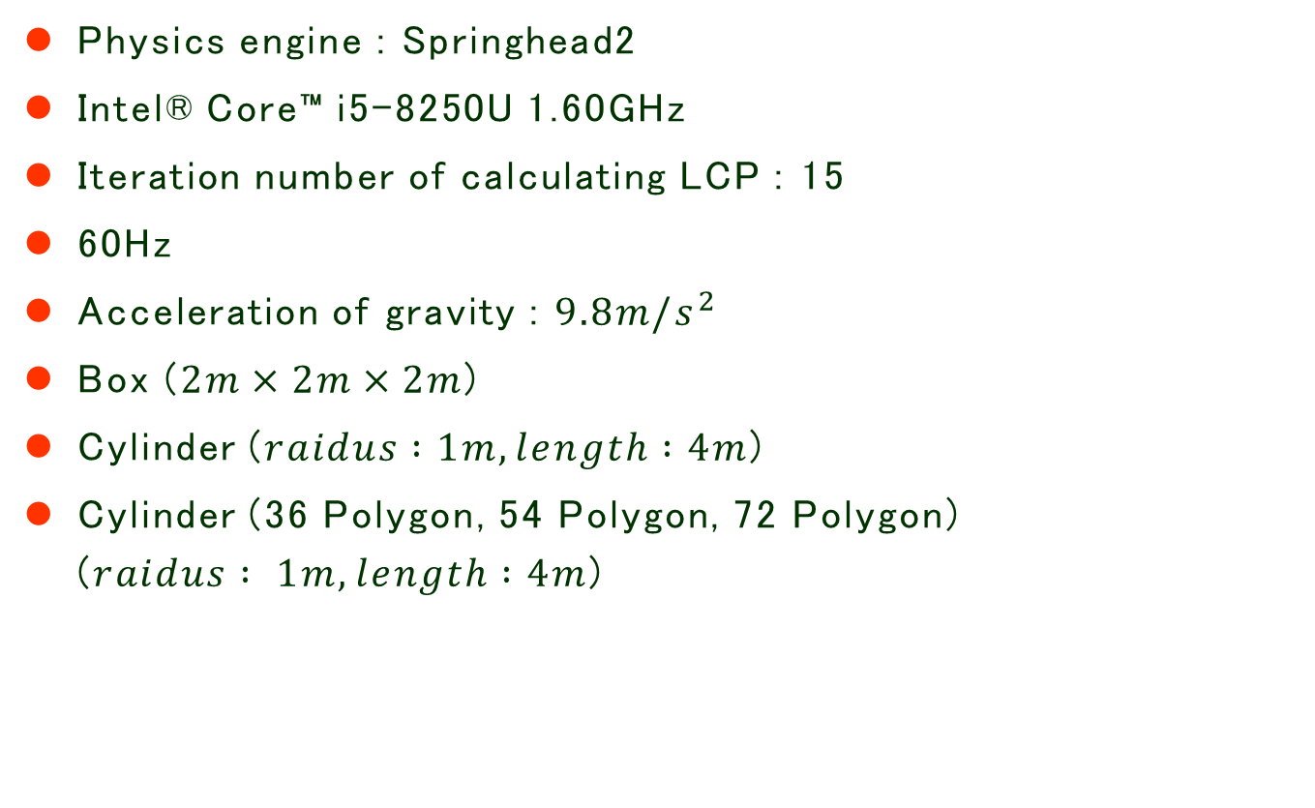
Evaluation (1)
Physics engine : Springhead2
Intel® Core™ i5-8250U 1.60GHz
Iteration number of calculating LCP : 15
60Hz
Acceleration of gravity : $9.8{m/s}^{2}$
Box ($2m×2m×2m$)
Cylinder ($raidus :1m, length :4m$)
Cylinder (36 Polygon, 54 Polygon, 72 Polygon) ($raidus : 1m, length :4m$)

Slide 29
Evaluation (2)
The scenes for evaluation (1) Cylinder is just on the ground (2) Cylinder fall down when contact is as to edge contact (3) Cylinder fall down when contact is as to point contact
Evaluation parts (1) Fidelity (by tracking the change of velocities in dynamical scene) (2) Calculation time (by measuring time for contact analysis and contact force calculation)

Slide 30
Evaluation (3)
Figure 18 the example that cylinder is just on ground

Slide 31
Evaluation (4)
1.2m
Figure 19 the example that cylinder fall down when contact is as to edge contact

Slide 32
Evaluation (5)
1.25m
1.25m
Figure 20 the example that cylinder fall down when contact is as to point contact

Slide 33
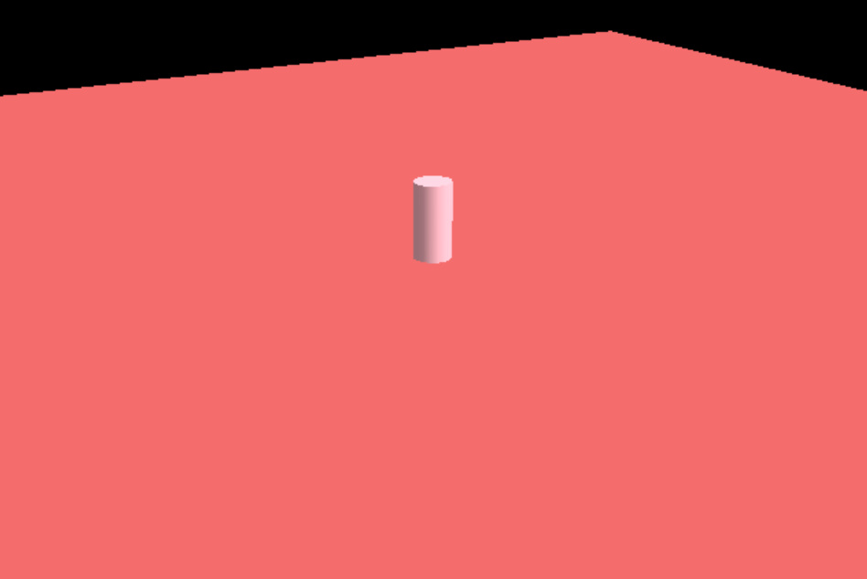
Evaluation (Calculation time-1)
Movie 2 Just on ground
Figure 21 The result of calculation time
(Cylinder falls down – Edge contact)

Slide 34
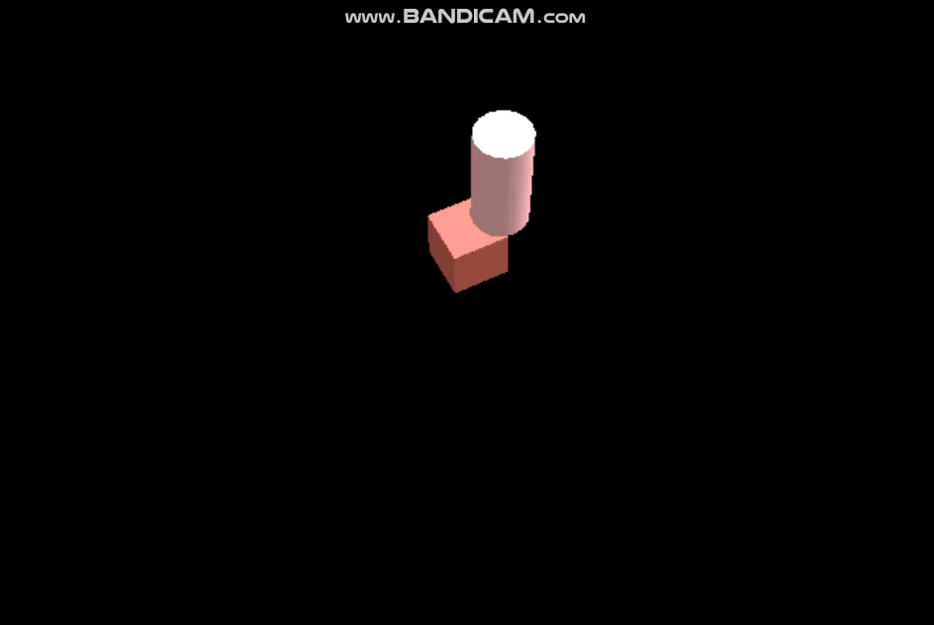
Evaluation (Calculation time-2)
Movie 3 falling down with edge contact
Figure 22 The result of calculation time
(Cylinder falls down – Edge contact)

Slide 35
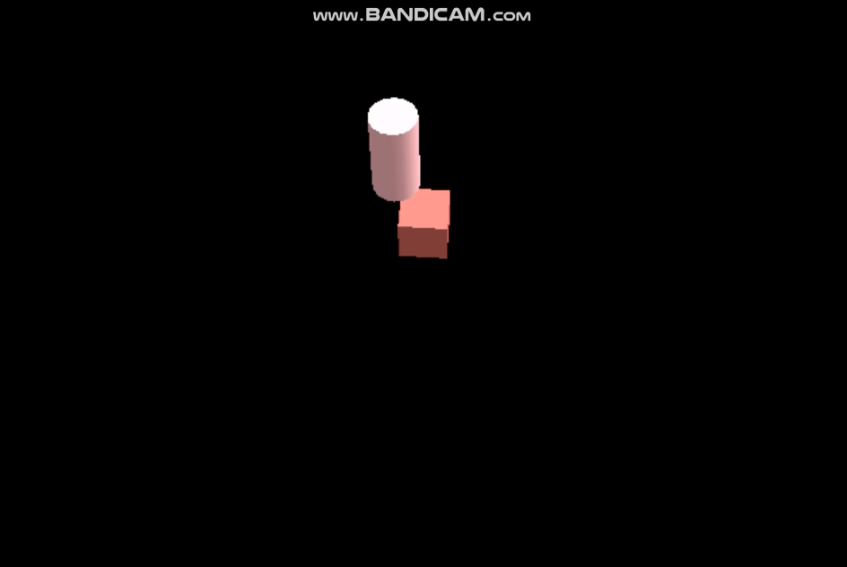
Evaluation (Calculation time-3)
Movie 4 falling down with point contact
Figure 23 The result of calculation time
(Cylinder falls down – point contact)

Slide 36
Evaluation (Fidelity-1)
Figure 24 The result of change of cylinder`s angular velocity (edge contact)

Slide 37
Evaluation (Fidelity-2)
Figure 25 The result of change of cylinder`s angular velocity (point contact)

Slide 38
Conclusion
The result of Evaluation show that this research has meaningful result at the scene stop position and falling down when contact is as to edge contact compared to conventional method
But, at the scene falling down when contact is as to point contact, The calculation contact force/torque time of 36 Polygon cylinder is more faster than calculation time using this research
Because, proposal method use complex algorithms (contact state judging and the closest point finding algorithm) in calculating contact force/torque compared to conventional method

Slide 39
Future work (1)
Implement the algorithm which find the closest point onto two convex objects and give fast convergence rates
Stabilization

Slide 40
Future work (2)
In my research, my algorithm for finding the closest point onto two convex objects is different from Euclidean Projection [2] (Appendix E)(Page 27)
this method assume that there are only two convex objects.
There is research paper to general object(nonconvex object) [3]

Slide 41
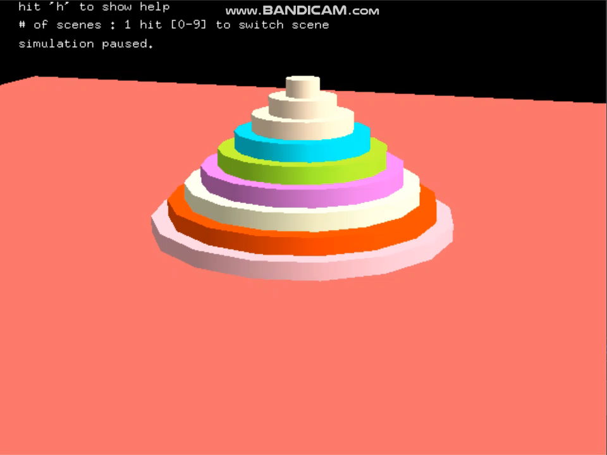
Future work (3)
Movie 5 the stack of cylinder

Slide 42
Future work (4)
So, there is method for stabilization to frozen these objects when the velocity of individual objects is smaller than standard speed.
But in springhead2, to frozen the object cannot be work now.
To change the value of freezezthreshold in SprPHEngine.h and use the function SetFrozen in UpdateVelocity function (PHSolid.cpp) both cannot be worked.

Slide 43
Future work (5)
If the only rule to frozen two objects by using the individual velocities, the tipping like moive 3 cannot be occurred
in stabilization in scene of stack of objects, it is important to calculate the axis of contact
From these facts, I must think two things : (1) how to frozen objects (the rule) (2) how to calculate the axis of contact
Movie 6 Tipping

Slide 44
Appendix A The data of Experiment (1)
Figure 26 The graph of entire calculation time (Cylinder falls down – Edge contact)

Slide 45
Appendix A The data of Experiment (2)
Figure 27 The graph of contact analysis calculation time (Cylinder falls down – Edge contact)

Slide 46
Appendix A The data of Experiment (3)
Figure 28 The graph of contact force/torque calculation time (Cylinder falls down – Edge contact)

Slide 47
Appendix A The data of Experiment (4)
Figure 29 The graph of entire calculation time (Cylinder falls down – Point contact)

Slide 48
Appendix A The data of Experiment (5)
Figure 30 The graph of contact analysis calculation time (Cylinder falls down – Point contact)

Slide 49
Appendix A The data of Experiment (6)
Figure 31 The graph of contact force/torque calculation time (Cylinder falls down – Point contact)

Slide 50
Appendix A The data of Experiment (7)
Figure 32 The graph of entire calculation time (Cylinder is just on ground)

Slide 51
Appendix A The data of Experiment (8)
Figure 33 The graph of contact analysis calculation time (Cylinder is just on ground)

Slide 52
Appendix A The data of Experiment (9)
Figure 34 The graph of contact force/torque calculation time (Cylinder is just on ground)

Slide 53
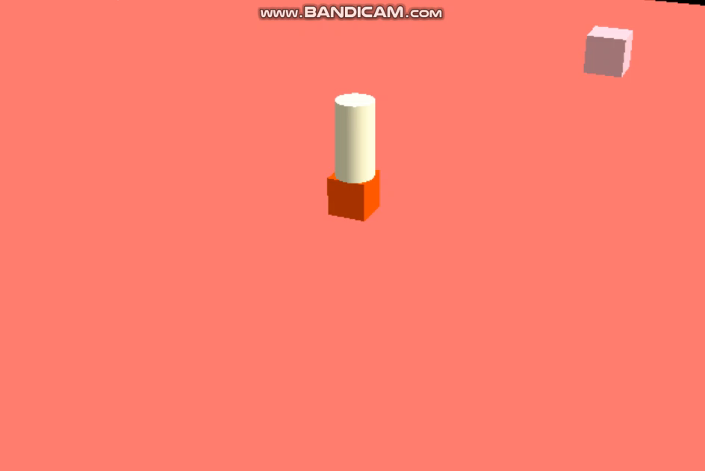
Appendix B Dynamical scene (1)
Movie 7 the collision with 3 objects (1)

Slide 54
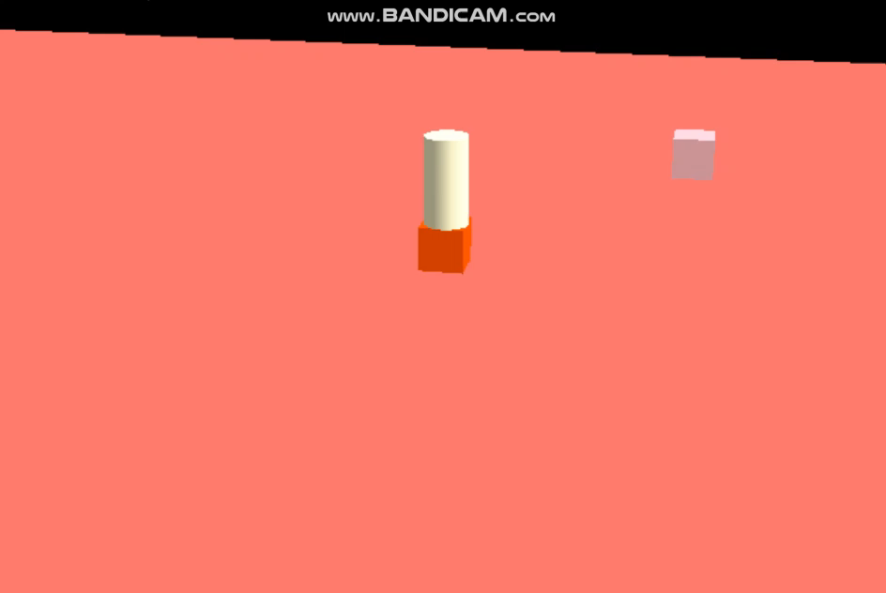
Appendix B Dynamical scene (2)
Movie 8 the collision with 3 objects (2)

Slide 55

Appendix B Dynamical scene (3)
Movie 9 Rolling cylinder

Slide 56
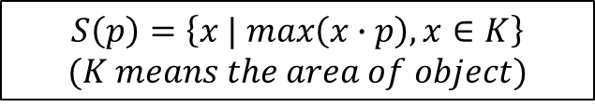
Appendix C The Algorithm of finding the closest point from constrained ZMP (1)
Support point
$$S\left(p\right)=\left\{x | max\left(x∙p\right), x∈K\right\}$$
$$(K means the area of object)$$
p
Figure 35 Support point

Slide 57
Appendix C The Algorithm of finding the closest point from constrained ZMP (2)
Finding the closest point from support point
Extract random point on object
From point generated step 1(point 1), draw the vector p1 which is point 1 to ZMP
Calculate S(p1)
If calculated point from step 2(point 2) is the same point 1, point 1 will be the closest point from ZMP
Draw the vector p2 which is point 2 to ZMP
Calculate S(p2)
Draw the line segment that ends of line segment are p1 and p2 (line 1), draw the vector(p3) from line1 to ZMP
Calculate S(p3)
If calculate point from step 8(point 3) is the same point from step 3 or 6, point 3 will be the closest point from ZMP
Figure 36 The simple example of the closest point finding algorithm

Slide 58
Appendix C The Algorithm of finding the closest point from constrained ZMP (3)
pt ← ZMP – the random point on object
Simplex = {} ← the set of Simplex
tmp ← S(pt)
while(1){
if(S(pt) exists in Simplex) return tmp;
else
switch(Simplex.number()){
case 0 : Simplex.add(S(pt)) && pt ← ZMP – S(pt)
case 1 : Simplex.add(S(pt)) && pt ← Vector from simplex(line segment) to ZMP
&& tmp = The starting point of pt (on the simplex)
case 2 : Simplex.add(S(pt)) && pt ← Vector from simplex（triangle） to ZMP
&& tmp = The starting point of pt (on the simplex)
case 3 : Simplex.add(S(pt)) && reomove the oldest point in Simplex
&& pt ← Vector from simplex(triangle) to ZMP
&& tmp = The starting point of pt (on the simplex)
}
}
Figure 37 The pseudo code of the closest point finding algorithm
Notes:
点でなくて面で拘束すると何が変わるか

Slide 59

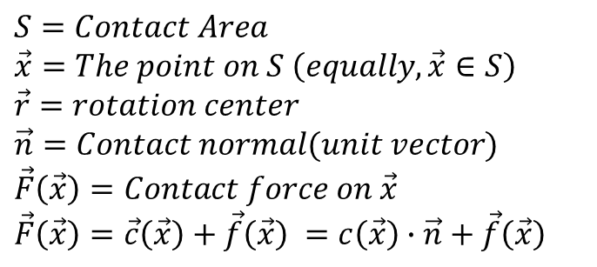







Appendix D (Zero Moment Point) (1)
$$S=Contact Area$$
$$\vec{x}=The point on S \left(equally,\vec{x}∈S\right)$$
$\vec{r}=rotation center$
$$\vec{n}=Contact normal(unit vector)$$
$$\vec{F}\left(\vec{x}\right)=Contact force on \vec{x}$$
$$\vec{F}\left(\vec{x}\right)=\vec{c}\left(\vec{x}\right)+\vec{f}\left(\vec{x}\right) =c\left(\vec{x}\right)∙\vec{n}+\vec{f}\left(\vec{x}\right)$$
$$\vec{r}$$
$$\vec{F}(\vec{x})$$
$$\vec{n}$$
$$\vec{n}$$
$$\vec{c}\left(\vec{x}\right)$$
$$\vec{x}$$
$$\vec{F}\left(\vec{x}\right)$$
$$\vec{f}\left(\vec{x}\right)$$
Figure 38 Entire state

Slide 60
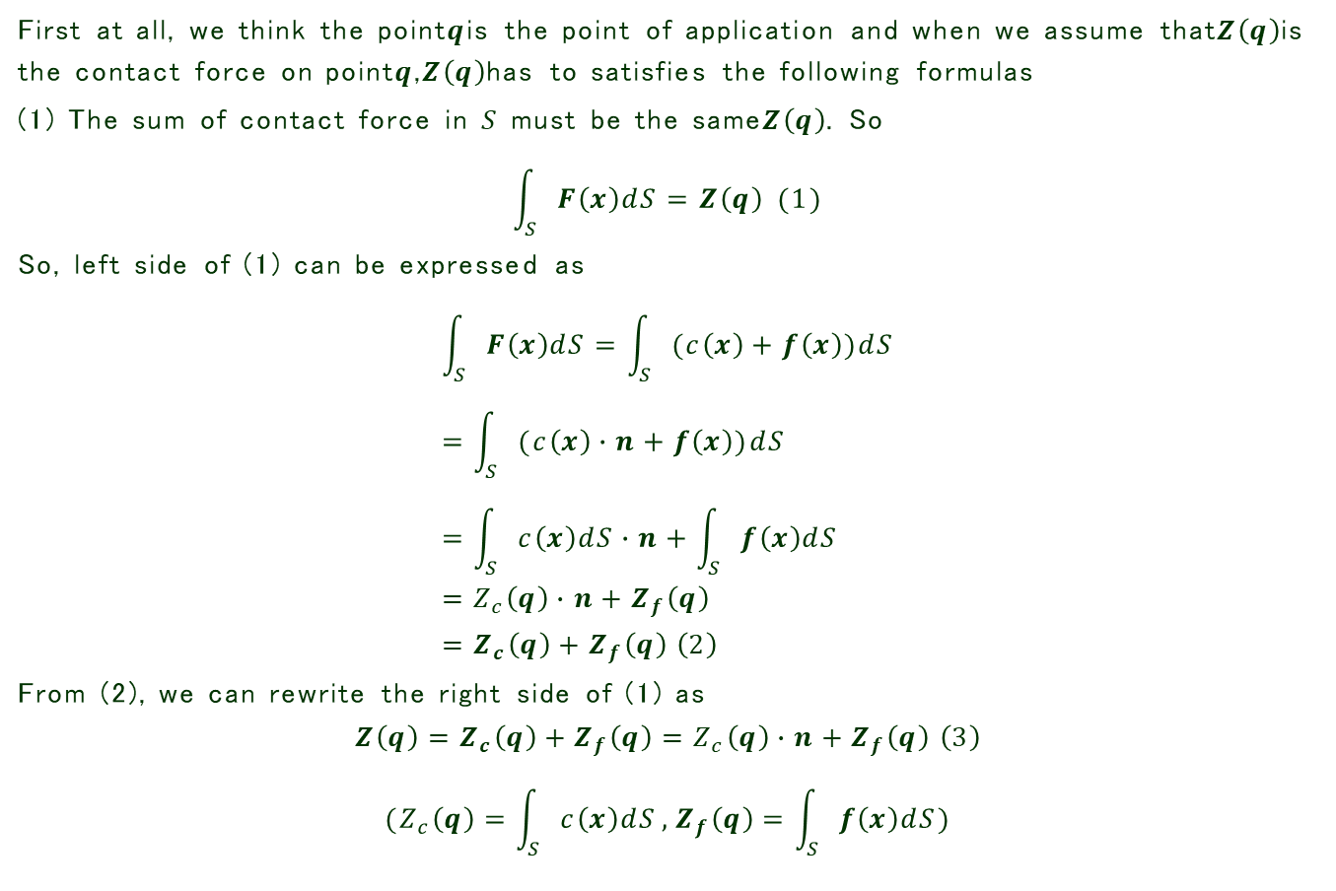
Appendix D (Zero Moment Point) (2)
First at all, we think the point$q$is the point of application and when we assume that$Z\left(q\right)$is the contact force on point$q$,$Z\left(q\right)$has to satisfies the following formulas
(1) The sum of contact force in $S$ must be the same$Z\left(q\right)$. So
$$\int_{S}{F\left(x\right)dS=Z\left(q\right)} (1)$$
So, left side of (1) can be expressed as
$$\int_{S}{F\left(x\right)dS}=\int_{S}{(c\left(x\right)+f\left(x\right))dS} \\ =\int_{S}{(c\left(x\right)∙n+f\left(x\right))dS} \\ =\int_{S}{c\left(x\right)dS}∙n+\int_{S}{f\left(x\right)dS} \\ =Z_{c}\left(q\right)∙n+Z_{f}\left(q\right) \\ =Z_{c}\left(q\right)+Z_{f}\left(q\right) \left(2\right)$$
From (2), we can rewrite the right side of (1) as
$$Z\left(q\right)=Z_{c}\left(q\right)+Z_{f}\left(q\right)=Z_{c}\left(q\right)∙n+Z_{f}\left(q\right) \left(3\right) \\ (Z_{c}\left(q\right)=\int_{S}{c\left(x\right)dS},Z_{f}\left(q\right)=\int_{S}{f\left(x\right)dS})$$

Slide 61
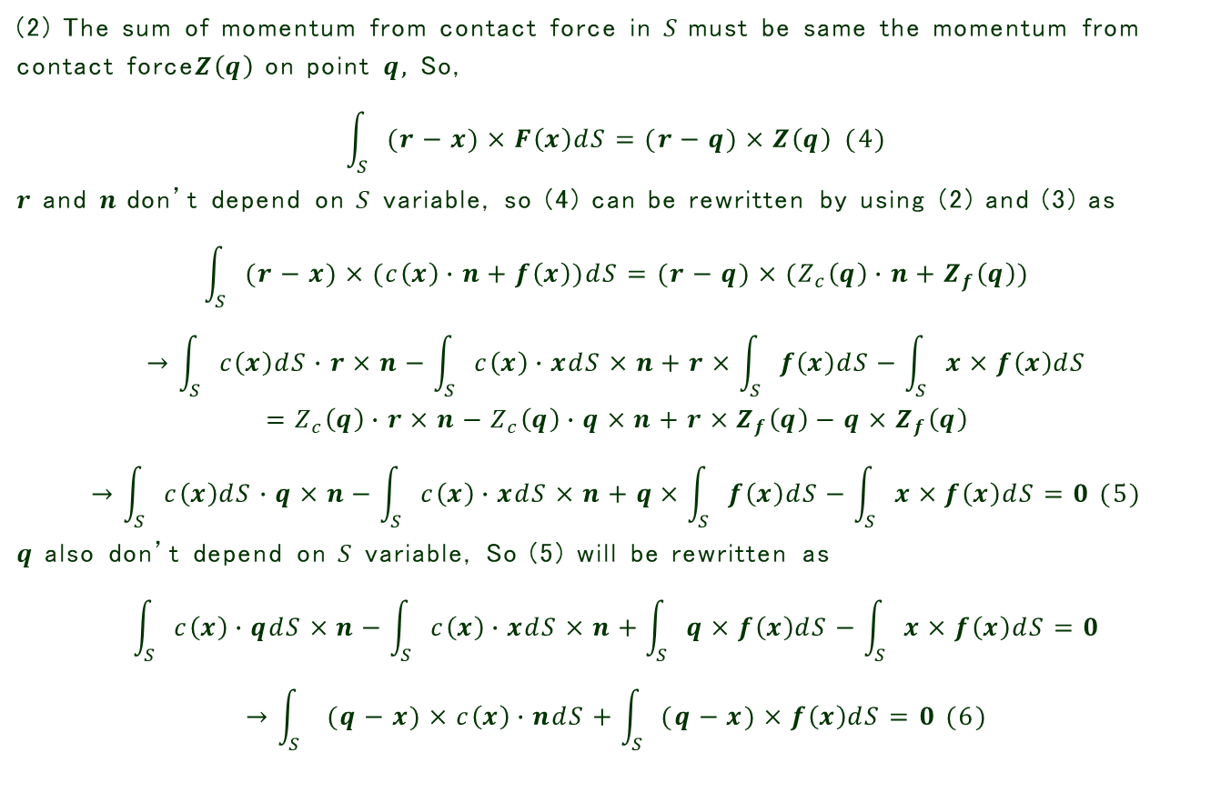
Appendix D (Zero Moment Point) (3)
(2) The sum of momentum from contact force in $S$must be same the momentum from contact force$Z\left(q\right)$ on point $q,$ So,
$$\int_{S}{(r−x)×F\left(x\right)dS=(r−q)×Z\left(q\right)} (4)$$
$r$ and $n$don’t depend on $S$ variable, so (4) can be rewritten by using (2) and (3) as
$$\int_{S}{(r−x)×(c\left(x\right)∙n+f\left(x\right))dS=(r−q)×(Z_{c}\left(q\right)∙n+Z_{f}\left(q\right))}$$
$$→\int_{S}{c\left(x\right)dS}∙r×n−\int_{S}{c\left(x\right)∙xdS}×n+r×\int_{S}{f\left(x\right)dS}−\int_{S}{x×f\left(x\right)dS} \\ =Z_{c}\left(q\right)∙r×n−Z_{c}\left(q\right)∙q×n+r×Z_{f}\left(q\right)−q×Z_{f}\left(q\right)$$
$$→\int_{S}{c\left(x\right)dS}∙q×n−\int_{S}{c\left(x\right)∙xdS}×n+q×\int_{S}{f\left(x\right)dS}−\int_{S}{x×f\left(x\right)dS}=0 (5)$$
$q$ also don’t depend on $S$ variable, So (5) will be rewritten as
$$\int_{S}{c\left(x\right)∙qdS}×n−\int_{S}{c\left(x\right)∙xdS}×n+\int_{S}{q×f\left(x\right)dS}−\int_{S}{x×f\left(x\right)dS}=0$$
$$→\int_{S}{ (q−x)×c\left(x\right)∙ndS}+\int_{S}{(q−x)×f\left(x\right)dS}=0 (6)$$

Slide 62
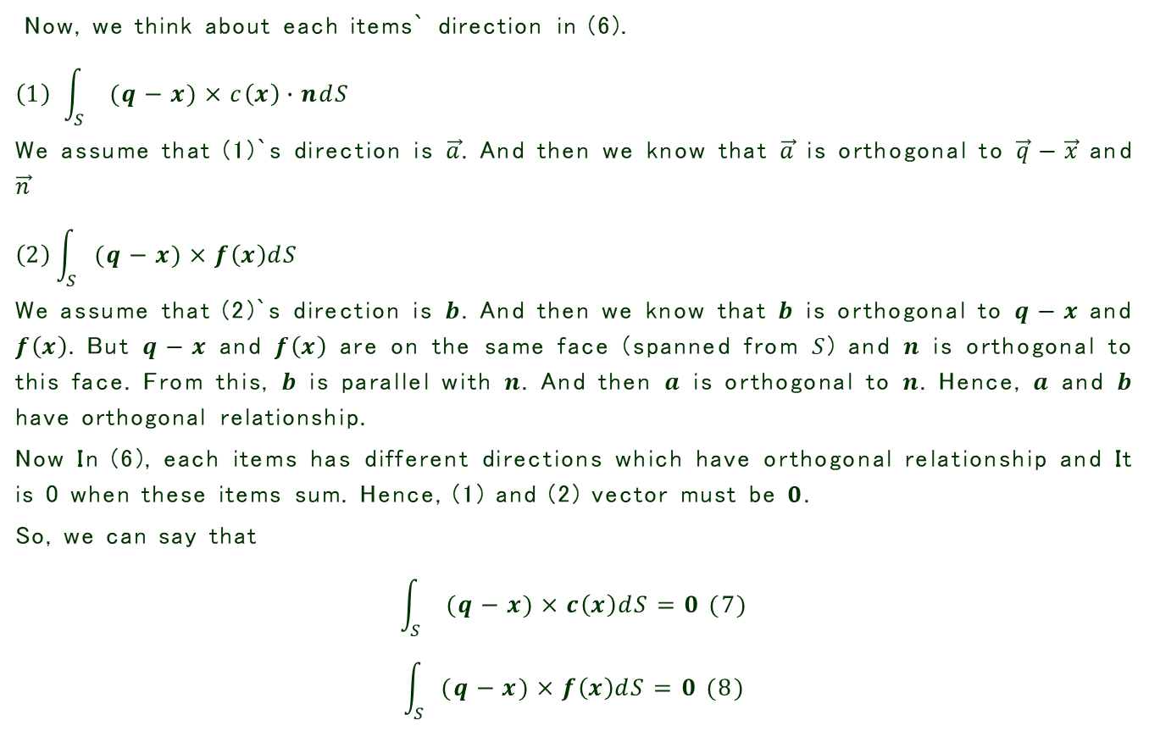
Appendix D (Zero Moment Point) (4)
Now, we think about each items` direction in (6).
$$\left(1\right) \int_{S}{ (q−x)×c\left(x\right)∙ndS}$$
We assume that (1)`s direction is $\vec{a}$. And then we know that $\vec{a}$ is orthogonal to $\vec{q}−\vec{x}$ and $\vec{n}$
$$\left(2\right)\int_{S}{(q−x)×f\left(x\right)dS}$$
We assume that (2)`s direction is $b$. And then we know that $b$ is orthogonal to $q−x$ and $f\left(x\right).$ But $q−x$ and $f\left(x\right)$ are on the same face (spanned from $S$) and $n$ is orthogonal to this face. From this, $b$ is parallel with $n$. And then $a$ is orthogonal to $n$. Hence, $a$ and $b$ have orthogonal relationship.
Now In (6), each items has different directions which have orthogonal relationship and It is 0 when these items sum. Hence, (1) and (2) vector must be $0$.
So, we can say that
$$\int_{S}{ (q−x)×c\left(x\right)dS}=0 (7)$$
$$\int_{S}{(q−x)×f\left(x\right)dS}=0 (8)$$

Slide 63
Appendix D (Zero Moment Point) (5)
From (7) , (8) the point of application satisfied that the sum of momentum is 0 on point of application. Also, from these, we can know the concept of ZMP must be used only in Convex object.
Figure 39 The example of Convex and Non-convex
Notes:
Non-convex 避けずに
ベクトルを太くしてする

Slide 64
Appendix E (Euclidean Projection)
2
1
Page 40
Figure 40 The example of Euclidean projection
Notes:
内側でとまるかもしらない。。。

